Slide 1
Gradients without Backpropagation
Pavel Popov

Slide 2
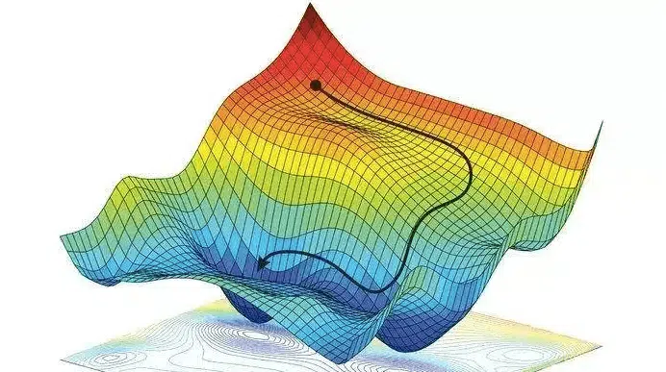
Gradient descent. Finding global minimum

Slide 3
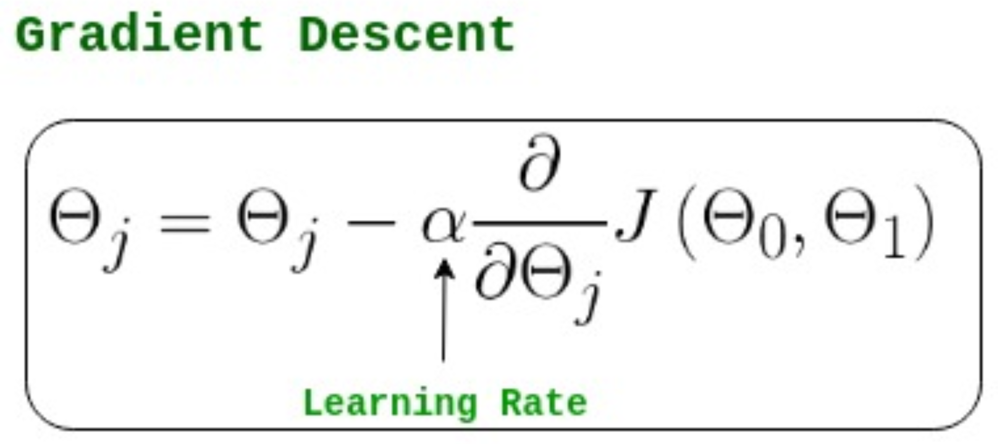
Gradient descent. Iterative updates

Slide 4
Gradient descent. How to improve?

Slide 5
Gradient descent. How to improve?
You can optimize the learning rate
Adagrad tunes learning rate for each variable j

Slide 6
Gradient descent. How to improve?
You can optimize the learning rate
Adagrad tunes learning rate for each variable j
You can optimize the update direction
Momentum approaches

Slide 7
Gradient descent. How to improve?
You can optimize the learning rate
Adagrad tunes learning rate for each variable j
You can optimize the update direction
Momentum approaches
You can speed up the gradient computation

Slide 8
Automatic differentiation
AD is a technique that allows to compute
the value of a function, and
the partial derivative of a function.

Slide 9
Automatic differentiation
AD is a technique that allows to compute
the value of a function, and
the partial derivative of a function.
Typically, complex functions (such as loss function in ML) can be represented as a sequence of simple functions.
Using chain rule, AD is capable to compute the gradient with high precision.

Slide 10
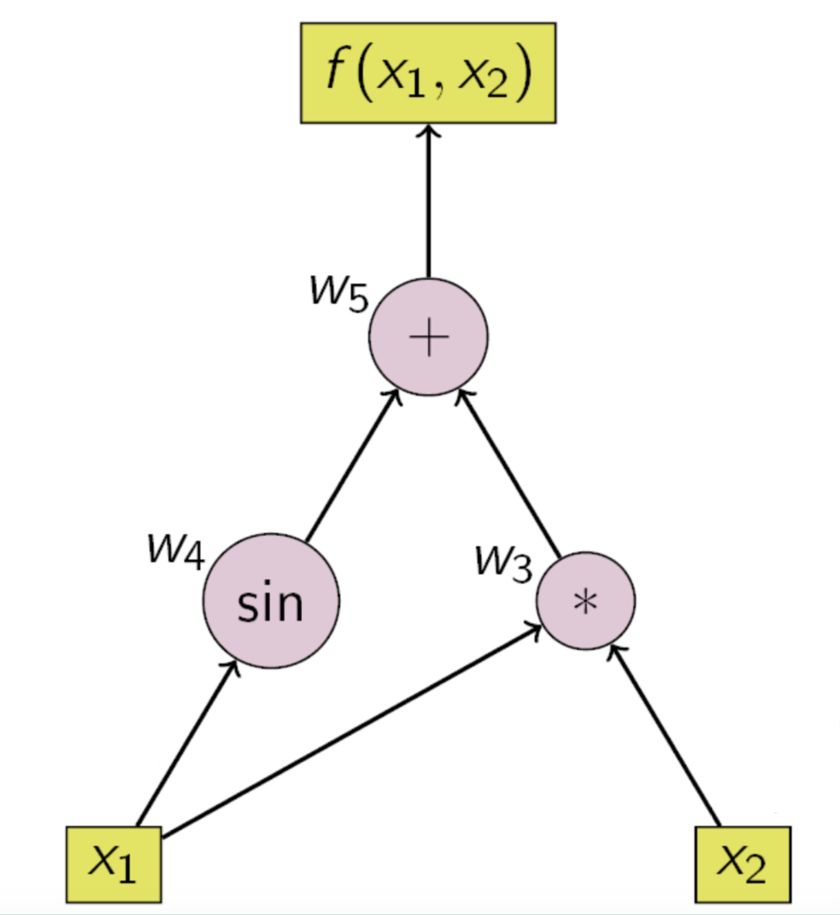
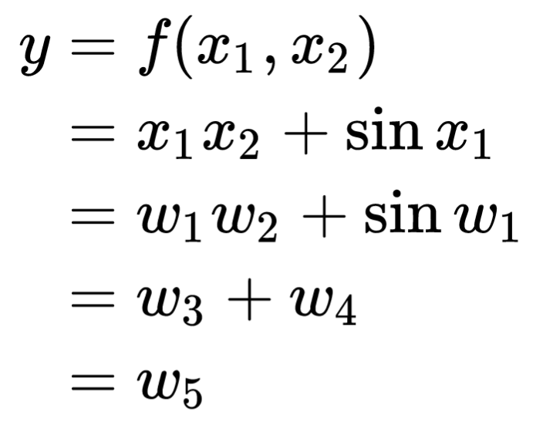
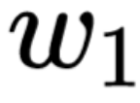
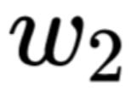
Automatic differentiation. Example

Slide 11
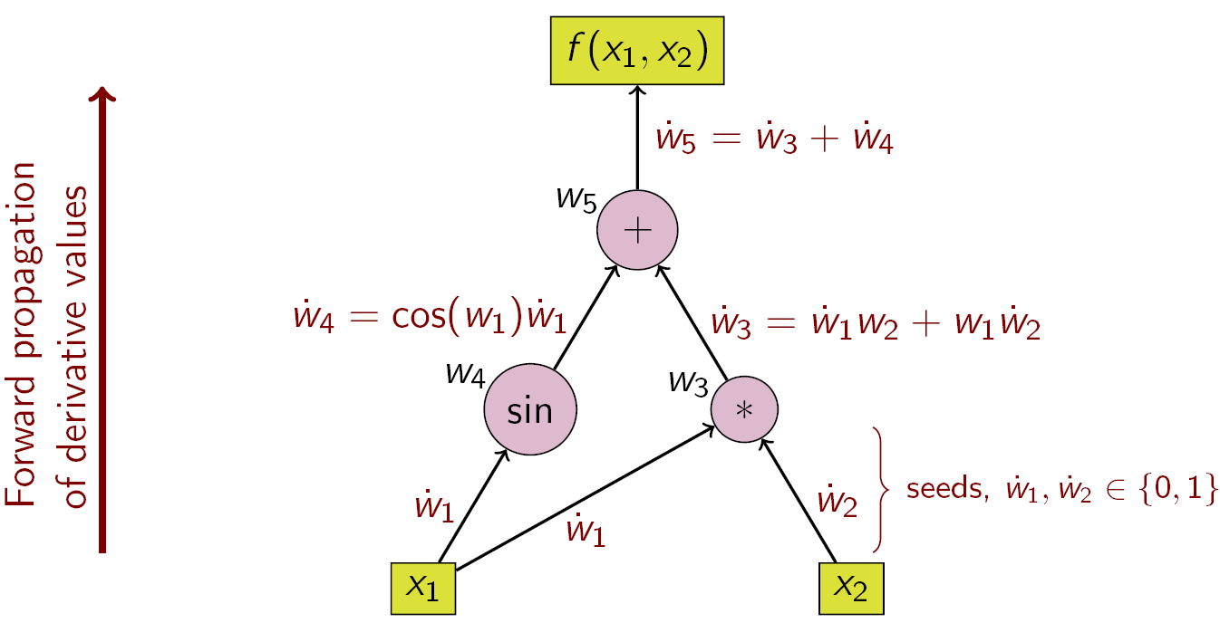
Forward mode

Slide 12
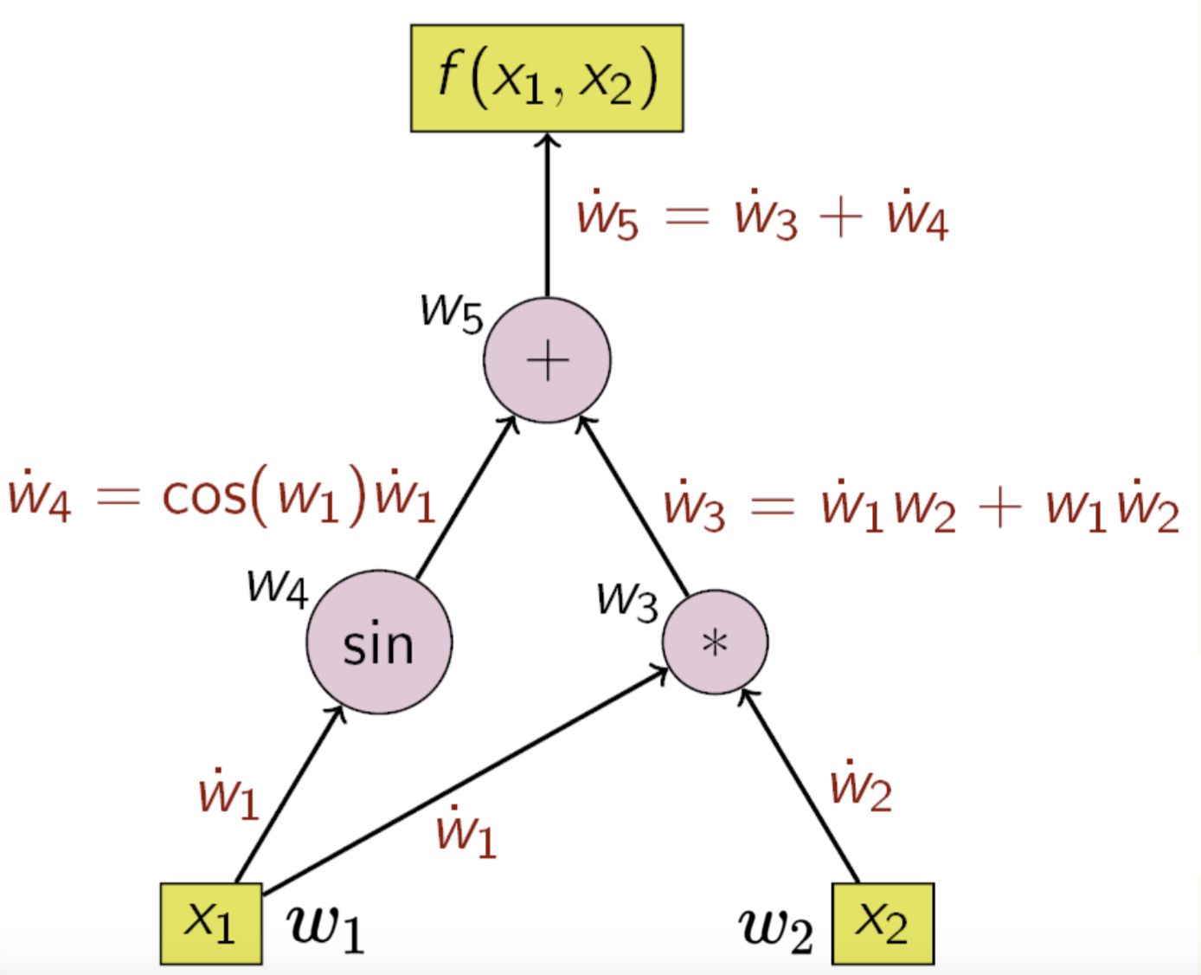
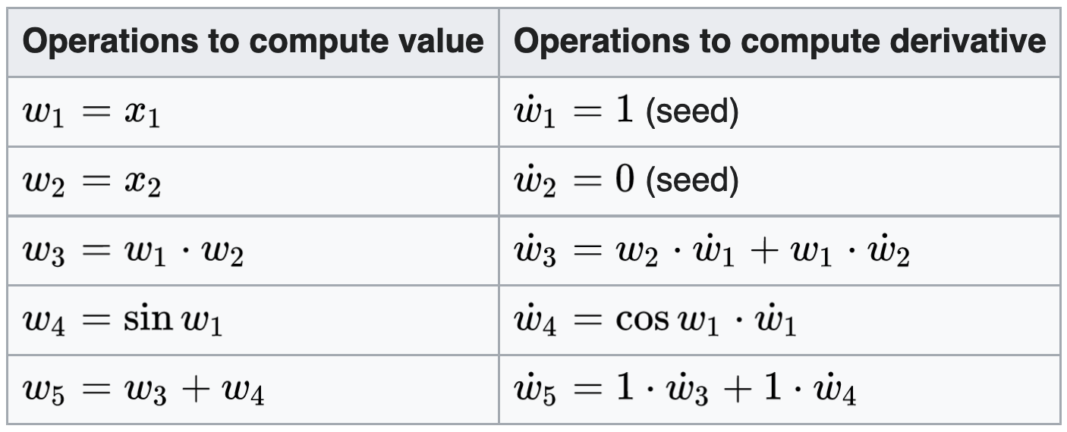
Forward mode. 1

Slide 13
Forward mode. 2

Slide 14
Forward mode. 3

Slide 15
Forward mode. 4

Slide 16

Forward mode. Nuances
complexity: R_{f} × runtime(f), R_{f} ∈ [1, 3]

Slide 17
Forward mode. Nuances
complexity: R_{f} × runtime(f), R_{f} ∈ [1, 3]
only one gradient component can be calculated in a single pass

Slide 18
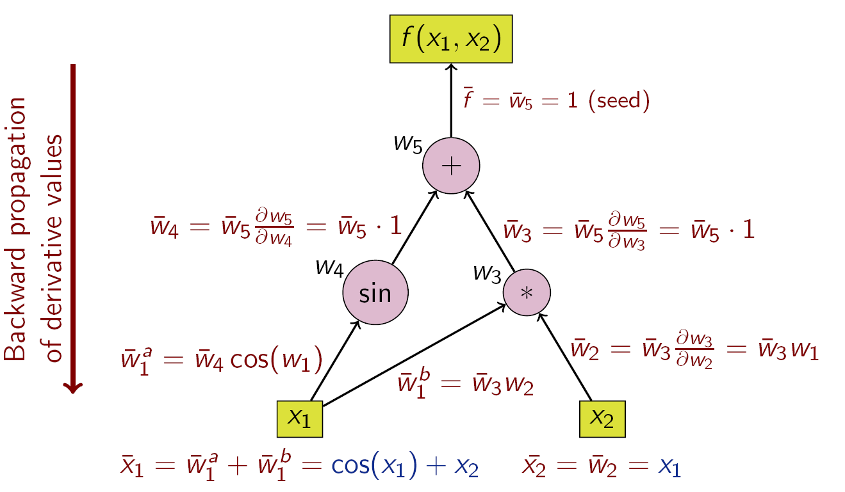
Reverse mode

Slide 19
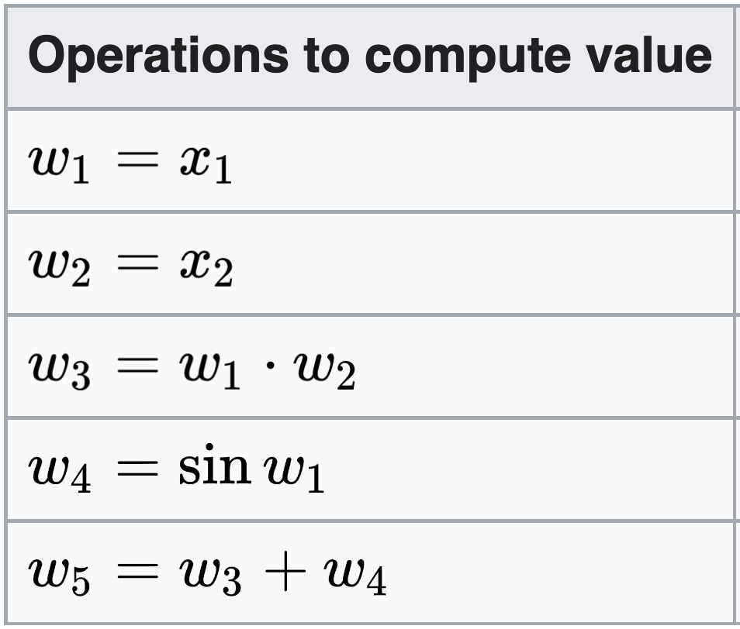
Reverse mode. 1

Slide 20
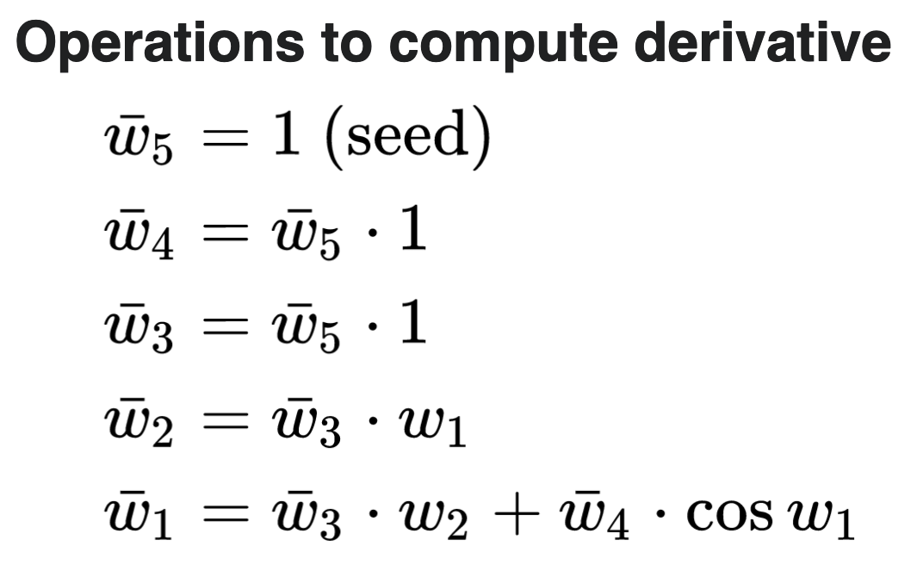
Reverse mode. 1

Slide 21
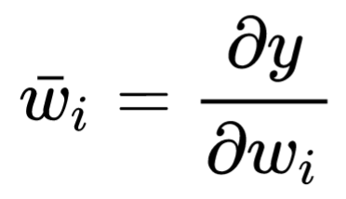
Reverse mode. 1

Slide 22
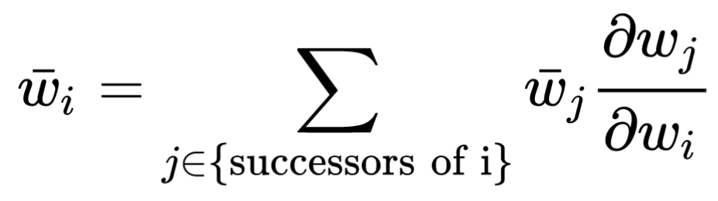
Reverse mode. 1

Slide 23
Reverse mode. 2

Slide 24
Reverse mode. 3

Slide 25
Reverse mode. 4

Slide 26
Reverse mode. 5

Slide 27
Reverse mode. 6

Slide 28
Reverse mode. 7

Slide 29
Reverse mode. Nuances
complexity: R_{b} × runtime(f), R_{b} ∈ [5, 10]

Slide 30
Reverse mode. Nuances
complexity: R_{b} × runtime(f), R_{b} ∈ [5, 10]
computes the whole gradient in a single pass, used in backprop

Slide 31
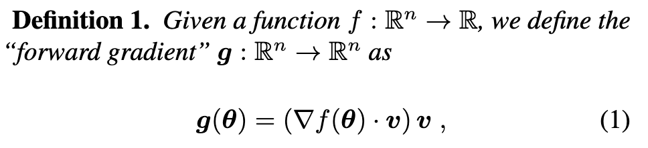
Forward gradient
v is a random vector of n components
v_{i} are randomly sampled from
a distribution with 0 mean and 1 variance

Slide 32
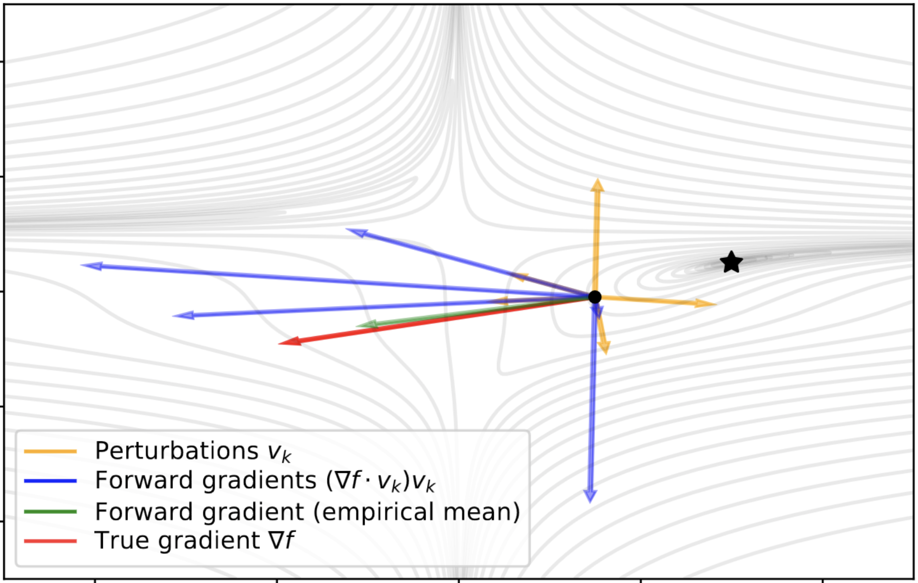

Slide 33
Recap of Forward mode
Seeds are actually a vector

Slide 34

Bias-less-ness

Slide 35
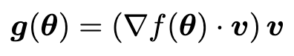
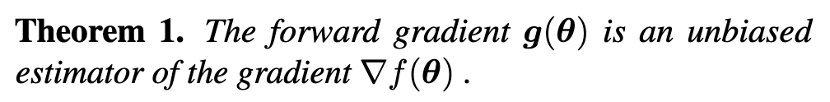
Bias-less-ness

Slide 36
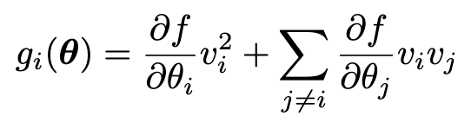
Bias-less-ness

Slide 37
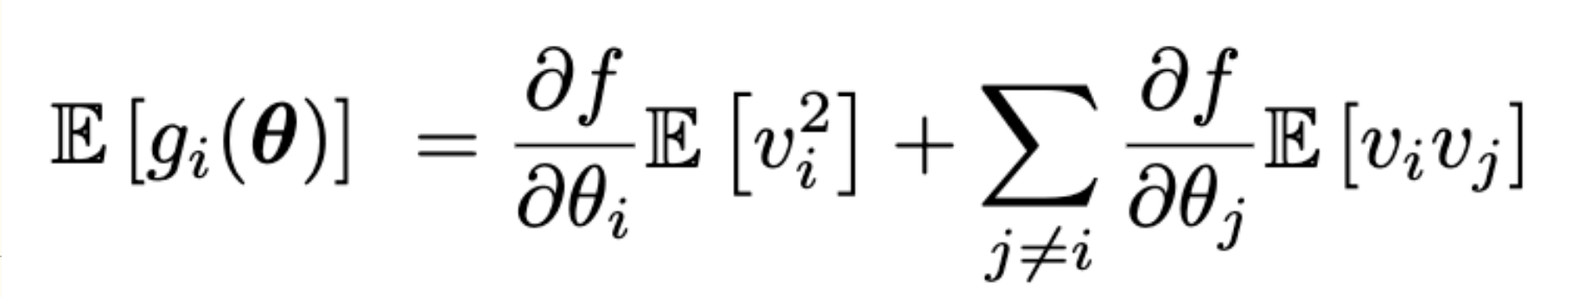
Bias-less-ness

Slide 38
Comparison with backprop gradient
Backprop gradient takes R_{b} × runtime(f), R_{b} ∈ [5, 10]

Slide 39
Comparison with backprop gradient
Backprop gradient takes R_{b} × runtime(f), R_{b} ∈ [5, 10]
Forward gradient takes R_{f} × runtime(f), R_{f} ∈ [1, 3]

Slide 40
Comparison with backprop gradient
Backprop gradient takes R_{b} × runtime(f), R_{b} ∈ [5, 10]
Forward gradient takes R_{f} × runtime(f), R_{f} ∈ [1, 3]
Typical R_{b}/R_{f} is around 2

Slide 41
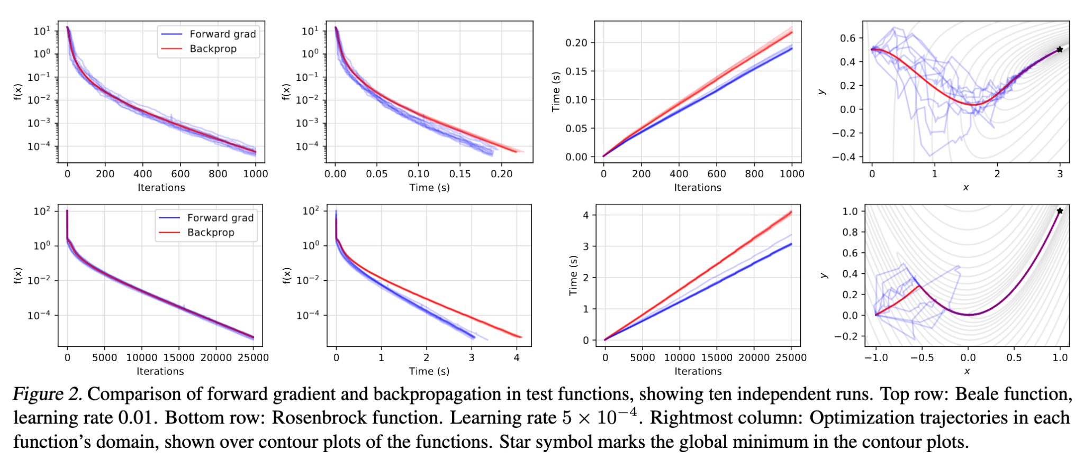
Experimental comparisons. Baseline problems

Slide 42
Experimental comparisons. Beale function

Slide 43
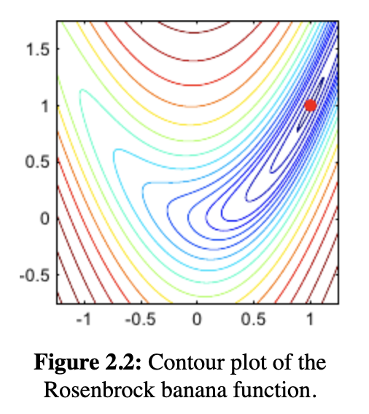
Experimental
comparisons.
Rosenbrock function

Slide 44
Experimental comparisons. Baseline problems

Slide 45
Experimental comparisons. Baseline problems

Slide 46
Experimental comparisons. Baseline problems

Slide 47
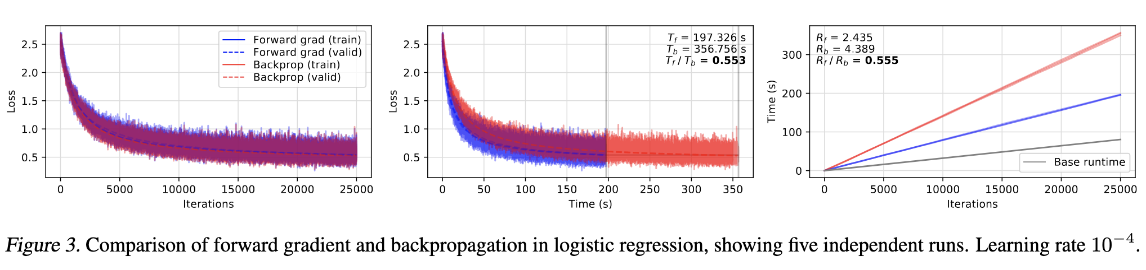
Experimental comparisons. Logistic regression

Slide 48
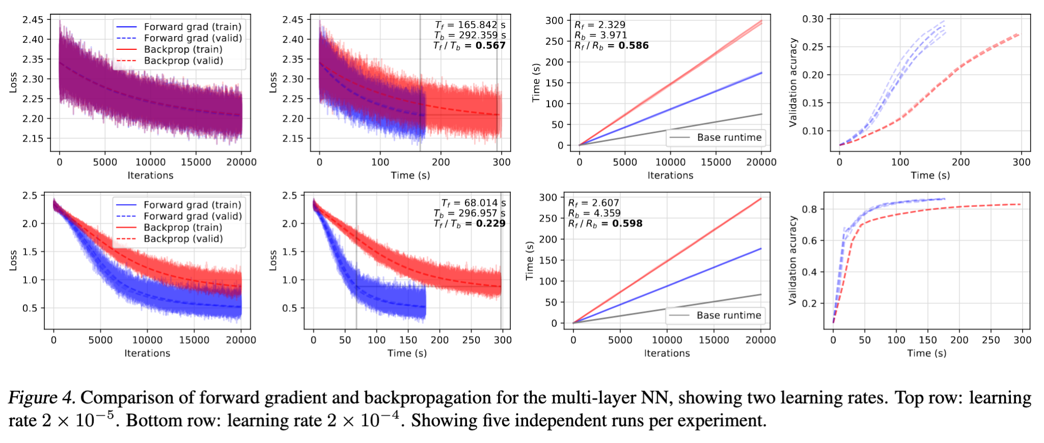
Experimental comparisons. MLP

Slide 49
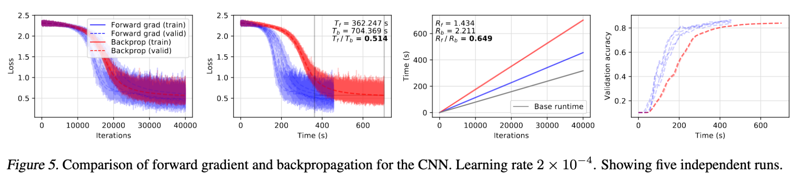
Experimental comparisons. CNN

Slide 50
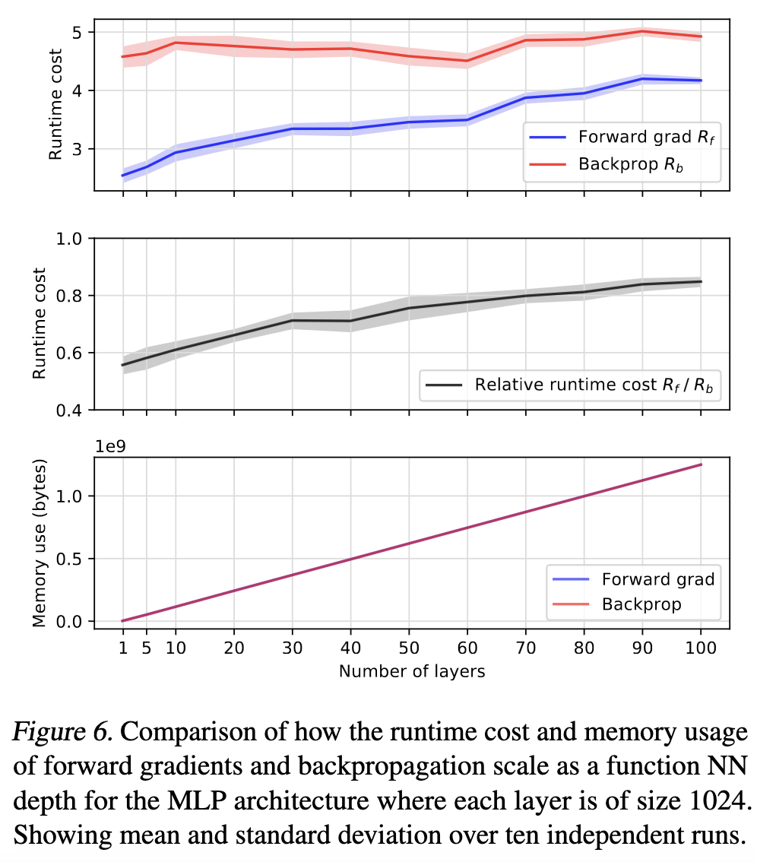
Experimental
comparisons.
Deep architecture

Slide 51
Summing up
We have a new technique to compute gradients

Slide 52
Summing up
We have a new technique to compute gradients
It uses forward mode AD → 2 times faster than backprop

Slide 53
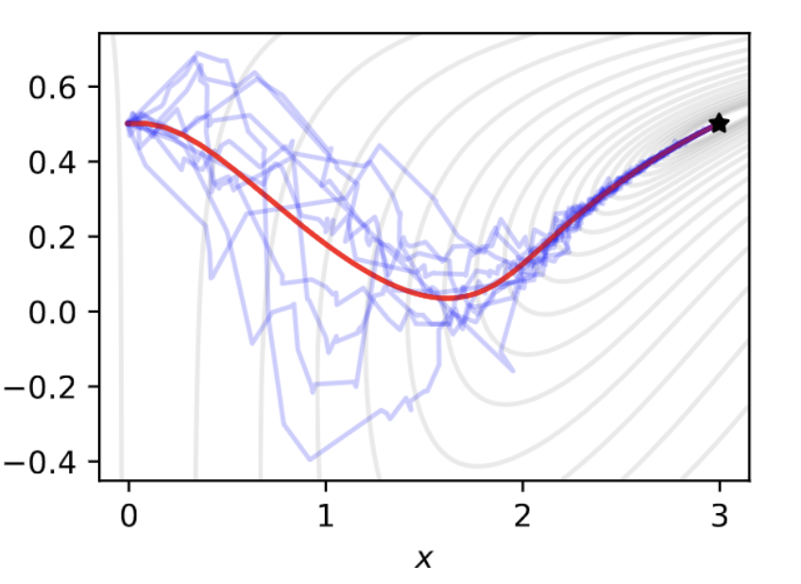
Summing up
We have a new technique to compute gradients
It uses forward mode AD → 2 times faster than backprop
It is more stochastic than a backprop gradient: vector v is random

Slide 54
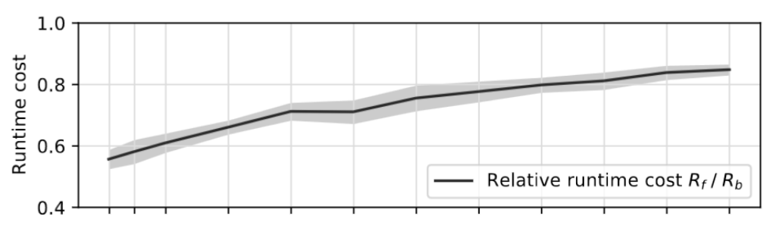
Summing up
We have a new technique to compute gradients
It uses forward mode AD → 2 times faster than backprop
It is more stochastic than a backprop gradient: vector v is random
It may not work this well with really deep architectures

Slide 55
Invitation to discussion
Forward gradient still relies on AD
AD relies on standard building blocks functions → It can not compute gradients of black box functions
It does not solve the problem of vanishing gradients?

